Slide 1
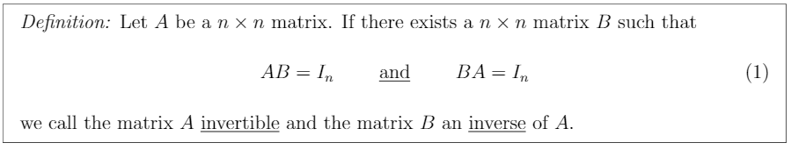
Invertible

Slide 2
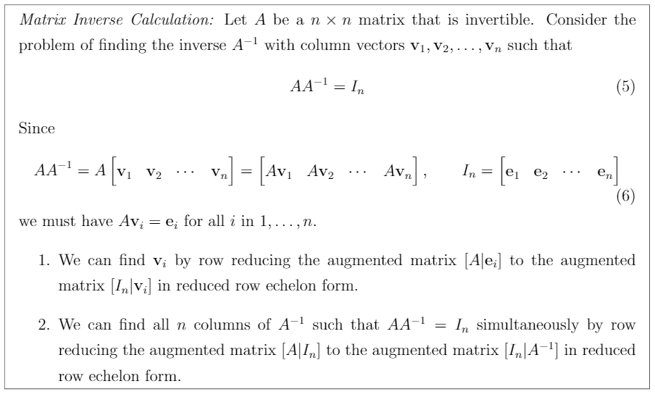
Matrix Inverse Calculation

Slide 3
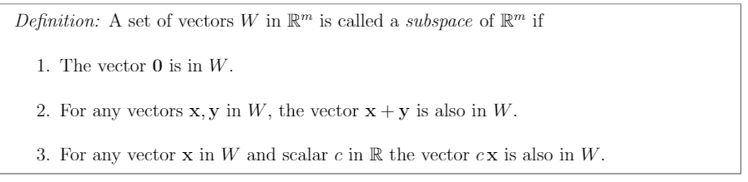
Subspace

Slide 4

Subspace

Slide 5
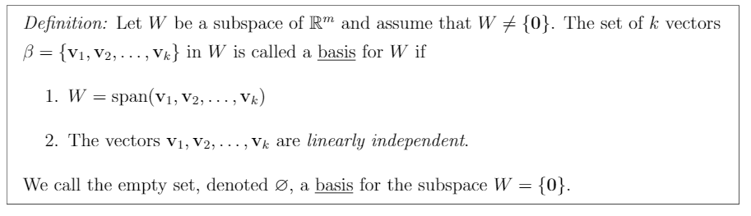
Basis

Slide 6
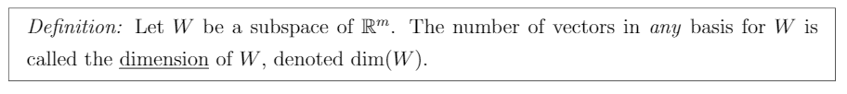
Dimension

Slide 7
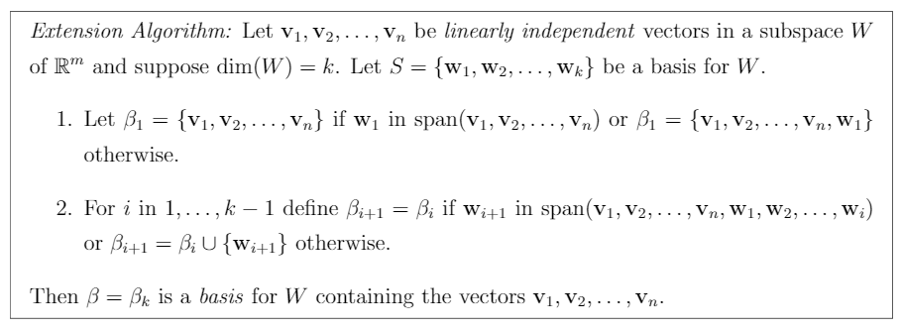
Extension Algorithm

Slide 8
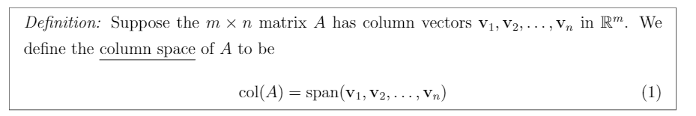
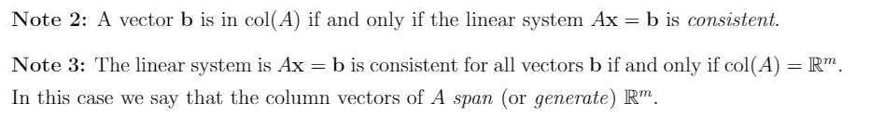
Column Space

Slide 9
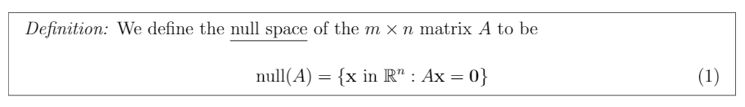
Null Space

Slide 10
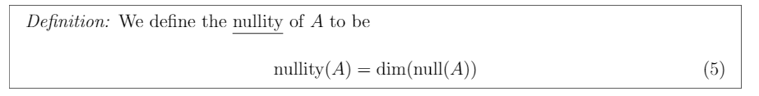
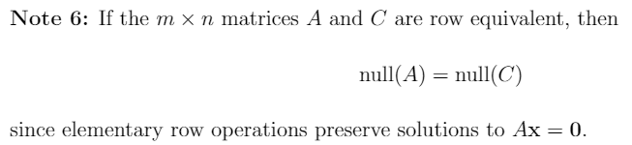
Nullity

Slide 11

Tranformation

Slide 12
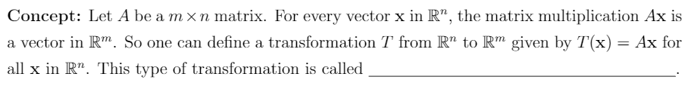
Matrix Transformation
Matrix Transformation

Slide 13
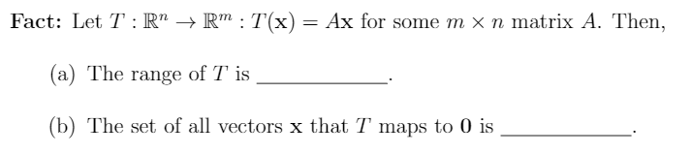
Range and Vector set of T (TBA)
col(A)
null(A)

Slide 14
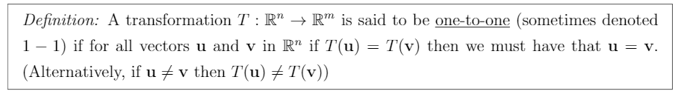
One To One

Slide 15
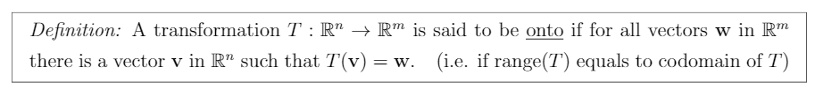
Onto

Slide 16
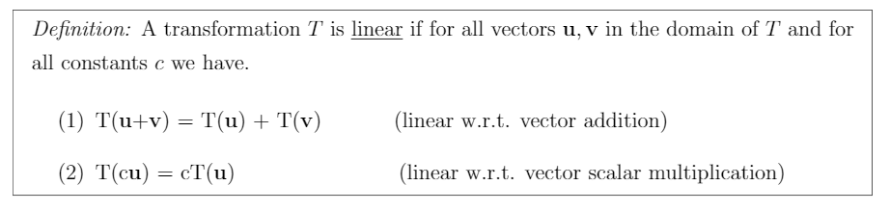
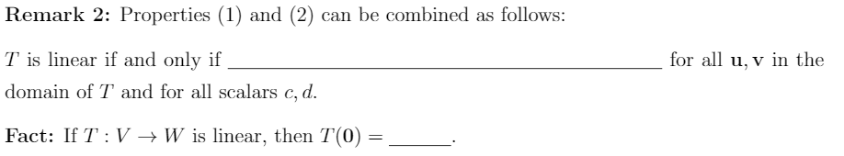
Linear Transformation
T(cu+dv) = cT(u) + dT(v)
0

Slide 17
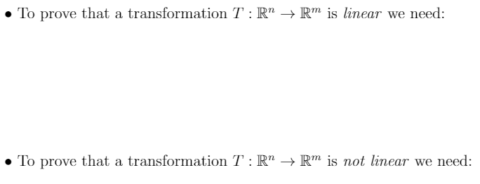
Linear transformation properties (1) and (2) hold for arbitrary vectors u and v in R^{m}
And for any real number c
Show T(0) != 0 or prove at least one linear transformation property (1) or (2)
Does not hold for a pair of vectors u, v or one vector v and a real number c
Linear/Nonlinear Transformation (TBA)

Slide 18
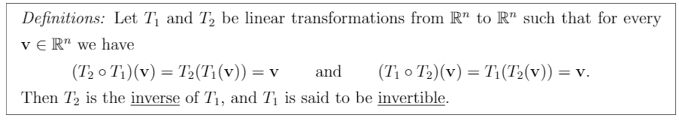
Linear Transformation Inverse

Slide 19
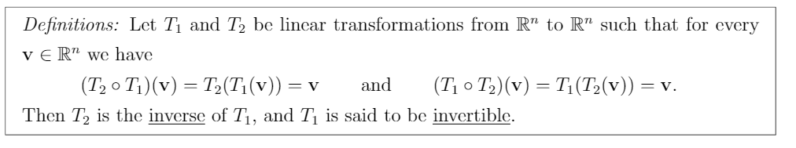
Invertible Transformations

Slide 20
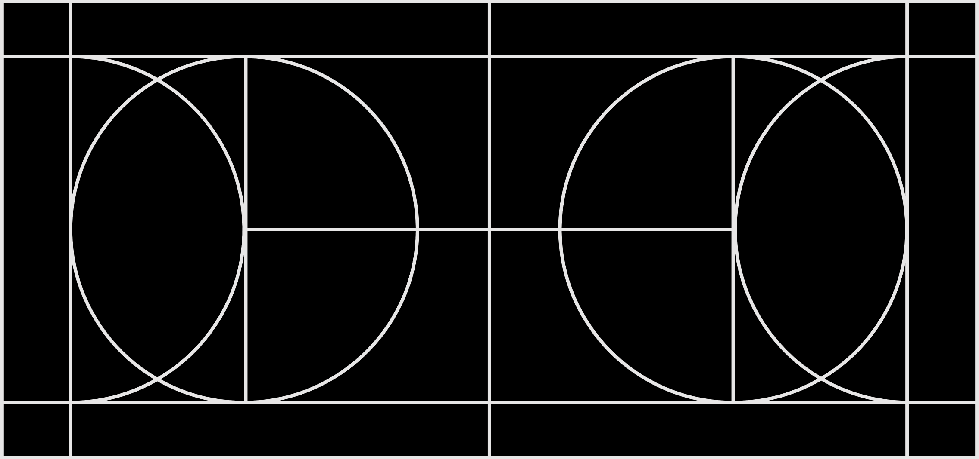
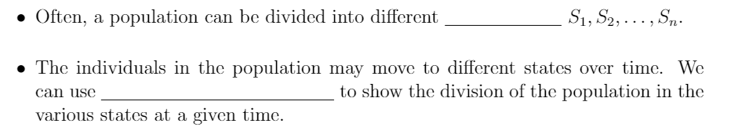
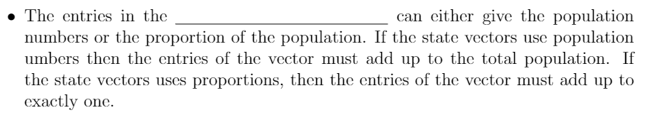
State and State Vectors
States
State Vectors
State Vectors

Slide 21
Probability Vector
Probability Vector

Slide 22
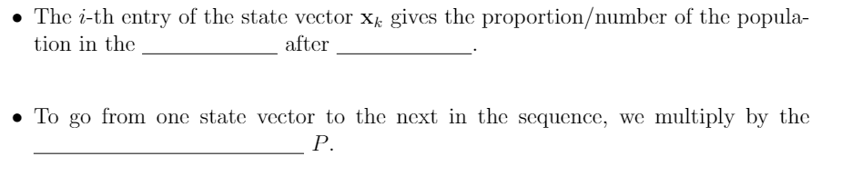
Markov Chain
Markov Chain
ith
k steps
Transition Matrix

Slide 23
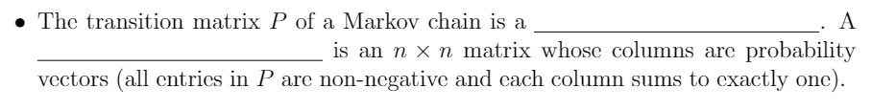
Stochastic Matrix
Stochastic Matrix
Stochastic Matrix

Slide 24
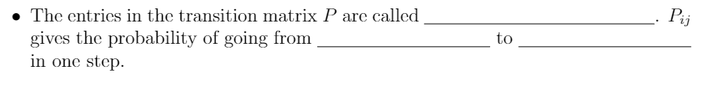
Transition Probabilities
Transition Probabilities
State j
State i

Slide 25
Steady State Vector
Steady State Vector

Slide 26
Steady State Probability Vector
Steady State Probability Vector

Slide 27
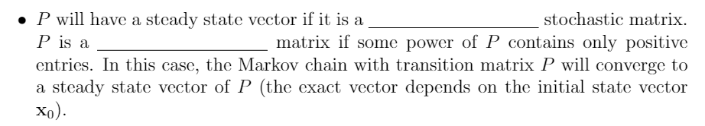
Regular Matrix
regular
regular

Slide 28
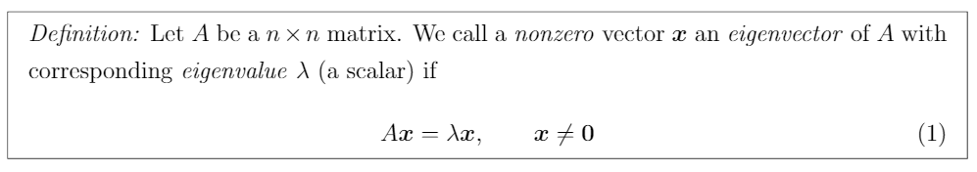
Eigenvector and Eigenvalue

Slide 29
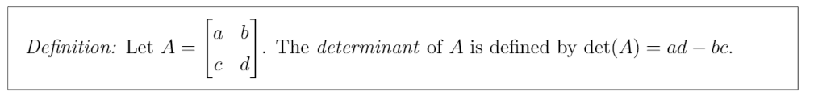
Determinant

Slide 30
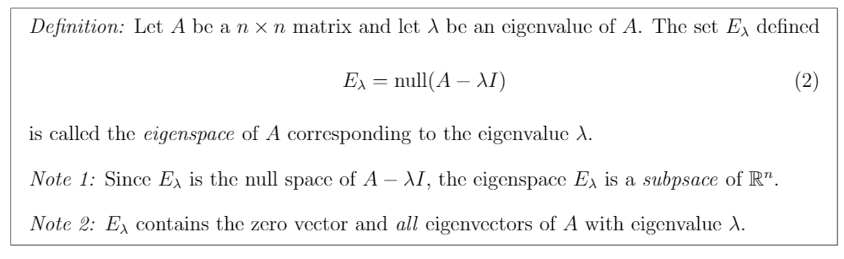
Eigenspace

Slide 31
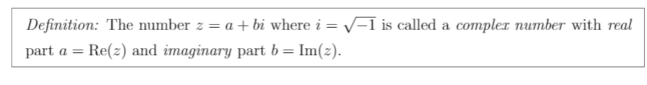
Complex and Imaginary Numbers

Slide 32
Complex Conjugate

Slide 33
Magnitude

